Slide 1
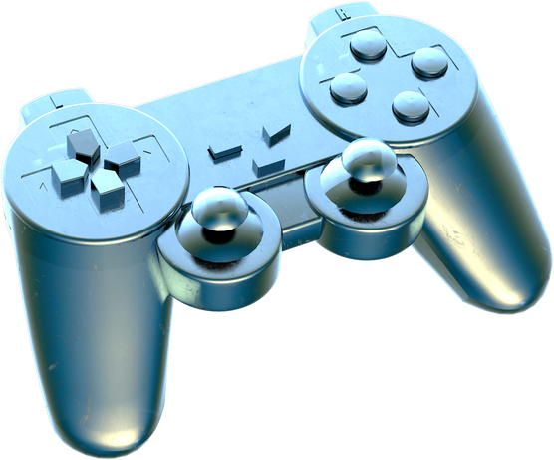

Project
SlideWaves
Wireless Virtual Mouse

Slide 2



Team Members
Herik Sevak
Piyush Thaware
161
233
Pawan Vadiya
Praful Gajbhiye
231
234
Payoj Mandpe
Satyendra Mourya
232
258
Under the guidance of Vaishali Surjuse Ma’am
KDK College Of Engineering , Nagpur
Department of Computer Science & Engineering
Date : 07/09/2023

Slide 3
ABSTRACT
In an era of rapid digital transformation, the way we interact with computers and digital devices has evolved significantly.
One of the key innovations driving this evolution is the advent of virtual mouse technology.
Virtual mouse technology replaces the physical mouse, allowing users to interact with the system without the need for a physical input device.

Slide 4
Literature Survey
In a dissertation by Ting Hie Ping, a PowerPoint gesture-based navigation system using Kinect was developed. The system recognizes various hand gestures based on the tracking information detected and performs mouse actions to navigate slides.
An article by ITM Web of Conferences proposed an automated digital presentation control system using hand gesture techniques. Users can change the slides of the presentation in both forward and backward directions by doing hand gestures.
A research paper by Research Square introduced a smart presentation system using hand gestures. The system employs machine learning to enable users to control and explore the slideshow.
In a thesis by Adam Fourney, a presentation Maestro controlling electronic presentations through gesture was designed and evaluated.

Slide 5


INTRODUCTION
What is a Virtual Mouse?
A virtual mouse is like a magic pointer that you can control with your computer or device without the need for a physical mouse.

Slide 6
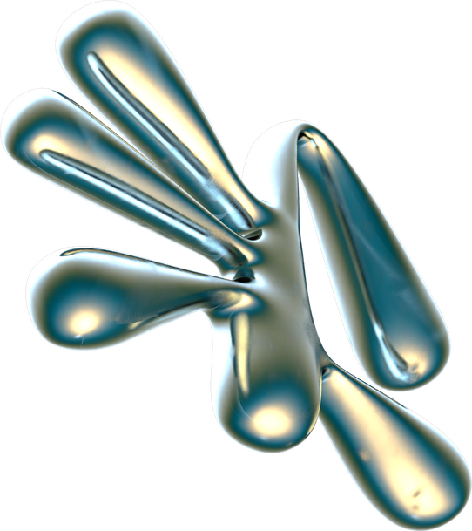
ENDLESS POSSIBILITIES
Reason : adjust their sensitivity, appearance, and even add extra features like gestures for more control
ACCESSIBLE TO EVERYONE:
Reason : blessing for people with disabilities as they offer alternative ways to interact with computers
NO MORE LOSING YOUR MOUSE
ECO-FRIENDLY OPTION
THE FUTURE OF COMPUTER INTERACTION
Key Features
NO MORE HARDWARE NEEDED
Reason : It's all done on your screen!
CONVENIENCE AT YOUR FINGERTIPS
Reason : Because you can use them on touchscreens,laptops, and desktop computers all the task you can do on your fingertips

Slide 7
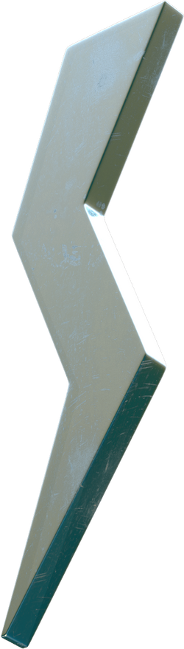
OBJECTIVE
MAJOR AIM:
Is to perform various operations of the cursor.
REDUCED HARDWARE DEPENDENCY
CONVENIENCE AND MOBILITY
CROSS-PLATFORM COMPATIBILITY
ENHANCED USER EXPERIENCE :
Improve the overall user experience by offering an alternative.
ENVIRONMENTAL RESPONSIBILITY:
Reducing electronic waste generated by discarded physical mice
SECURITY AND PRIVACY:
Implement security features to protect users from unauthorized virtual mouse access and maintain user privacy.

Slide 8
PROBLEM STATEMENT
This project is to develop a Virtual Mouse using Hand Gesture Recognition
The hand gestures are the most effortless and natural way of communication.
The aim is to perform various operations of the cursor.
Instead of using more expensive sensors, a simple web camera can identify the gesture and perform the action.
It helps the user to interact with a computer without any physical and hardware device to control mouse operation.

Slide 9
PLAN FOR FUTURE WORK
Firstly, we are working on two different modules of our project, which include the following
1. |  | 2. |  | 3. |  | 4.
Working on Power Point Presentation using a virtual mouse. |  | Creating a Chrome extension for cross-platform compatibility. |  | Integrating both the functionality together for creating a unique product. |  | For (Point no 1) we are going to create a blank background in which we have a upload functionality where user can upload that ppt and able to the virtual mouse functionality using a extension or a software.

Slide 10
REFERANCE
I1. Vantukal Reddy. Thumma Dhyanchand, Galla Vamsi, Krishna,Satish Maheshwaram "Virtual Mouse Control Using Colored Fingertips and Hand Gesture Recognition", 11-12 Sep 2020 https://ieeexplore.ieee.org/document/9242677
Kollipara Sai Varun. I Puneeth, Dr.T.Prem Jacobi "Virtual Mouse Implementation Using Opencv ",2019 -
https://ieeexplore.ieee.org/document/8862764

Slide 11
Do you have
any questions?

